Slide 1
Banking Marketing Data Analysis
Dane Isenberg, Johanky Reyes, Alexis Ondongo

Slide 2
Introduction
Data from Portuguese Bank Marketing Campaign (2008-2013)
Bank question: what characteristics of clients lead to them to subscribing to a term deposit?
Reason: marketing optimization to reduce cost/resources, targeting of individuals?

Slide 3
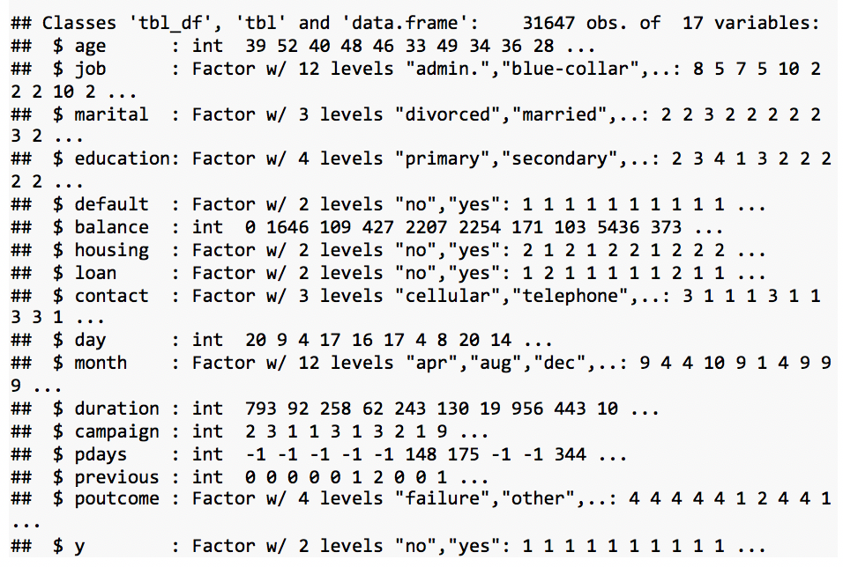
Exploratory Data Analysis
Snapshot of Data
Response : whether or not client get term deposit
16 Predictors (characteristics): demographic information (age, martial status etc.), socioeconomic indicators (education level, housing loan etc.), and type of contact (time of day, duration etc.).

Slide 4
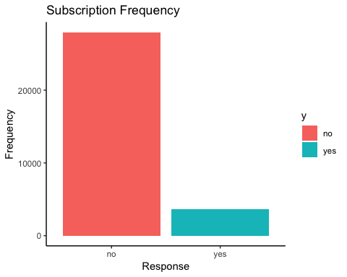
Exploratory Data Analysis
Response Variable
Yes = 11.65%
No = 88.35%
High proportion of non-subscription.

Slide 5
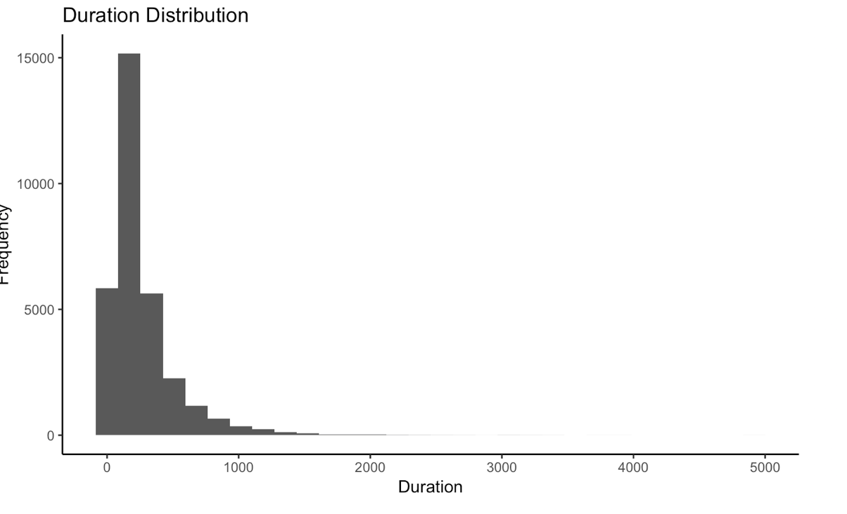
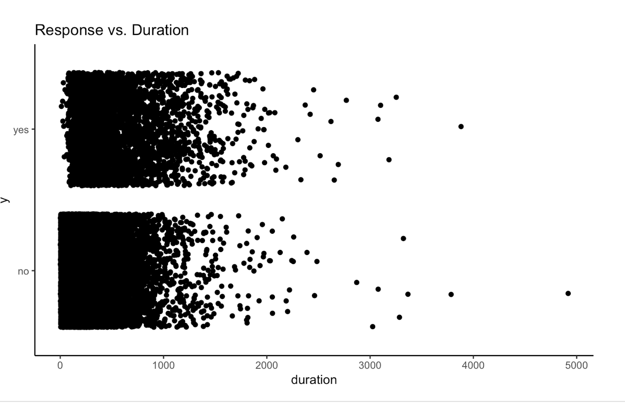

Exploratory Data Analysis
Example Predictors : Duration and Poutcome
Duration: the amount of time spent (in seconds) in last contact with client
Duration Frequency:
Response vs. Duration:
As duration increases, success rate increases.

Slide 6
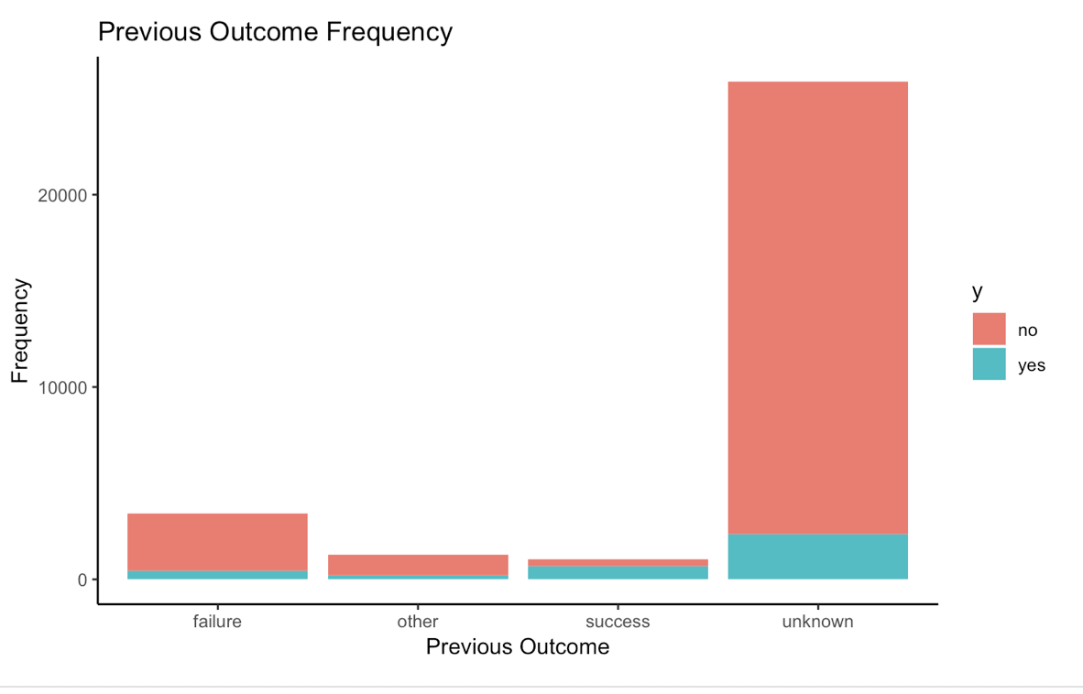
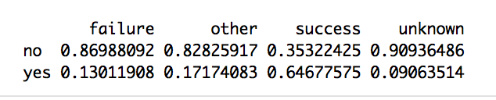
Exploratory Data Analysis
Example Predictors : Duration and Poutcome
Poutcome: outcome of previous marketing campaign
Poutcome Stacked Bar Chart
Previous success strong predictor of success in current campaign
:

Slide 7
Modeling Options
Parametric
Model | Tuning Parameters | Accuracy % - 5-Fold CV
Logistic Model (GLM): full set of predictors | N/A | 90.13
Backward Selection – Step AIC: 13 of 16 predictors | N/A | 90.13
Penalized Regression – Elastic Net (best tuned) | Alpha = .07 (closer to LASSO) Lambda = .003 (regularization) | 90.17
Logistic Model (GLM): 2 of 16 predictors (poutcome and duration) | N/A | 90.00
Logistic Model (GLM): poutcome, pdays binary | N/A | 90.16

Slide 8
Modeling Options
Non-Parametric
Model | Tuning Parameters | Accuracy % 5-Fold CV
K-Nearest Neighbors (best tuned) | K=25 | 88.72
Random Forest (best tuned) | ntree =2000 mtry = 4 | 90.84*
Boosting Trees (best tuned) | n.trees = 1000, interaction.depth = 3 shrinkage = 0.1 | 90.72
Support Vector Machine (too computationally onerous)

Slide 9
Conclusions
What we learned?
Best prediction model – random forest
Most practical model – stepwise AIC GLM
Variable importance: Gini Index (RF) and P-Value (GLM) – Duration, Poutcome, Month, Balance, and Age
Limitations : “Unknown Categories”, Tuning Parameter Optimization
Further Analysis: Inferential Statistics, Predatory Marketing

Slide 10
Wrap-Up
“ Far better an approximate answer to the right question, which is often vague, than an exact answer to the wrong question, which can always be made precise” John Tukey

